Slide 1

Open Source Data Processing With
Corey Snipes
Twomile Heavy Industries, Inc.
UCANR DroneCamp - June 24, 2020

Slide 2
Agenda
Background
How ODM Works
Use Cases
Using ODM
(Start Hands-on Processing)
Outputs
Pitfalls, Future Direction
Learning Resources
QA/Break
Hands-On Exercises

Slide 3
Background

Slide 4
About Me
Senior Software Engineer, Mosaic ATM
Board President, North Coast Drone Alliance
Drone industry participant ~5 years
Part 107 Remote Pilot (<1 year)
Contributor in the OpenDroneMap ecosystem

Slide 5
Why Open Source
FOSS is popular in academic and research settings, but why?
Accessible to orgs and programs with limited budgets
Pix4D is $292-$350/mo -OR- $4,990 one-time
ODM is $0* (free forever)
But equally important:
Control over your toolchain (change if you want)
Shoulders of giants: many contributors, collective wisdom
Transparency leads to greater
Quality
Security
*You can pay for certain parts, but not required.

Slide 6
ODM History
End of 2013 - Began as a joke on Geohipster
End of 2014 - Funded, organized FOSS project with multiple contributors
2015-2018 - Quietly expanded and refined tools and workflow
2018-2020 - Significant UI/ feature improvements, wider adoption
Today - Active community of international users, contributors

Slide 7
ODM Goals
Humanitarian
Ecology, conservation
Research
Data for the public good

Slide 8
The Process

Slide 9
ODM and the Photogrammetric Process
Structure from Motion
Point Cloud Densification
Poisson Surface Reconstruction
Multi-View Stereo Texturing
Orthophoto Generation

Slide 10
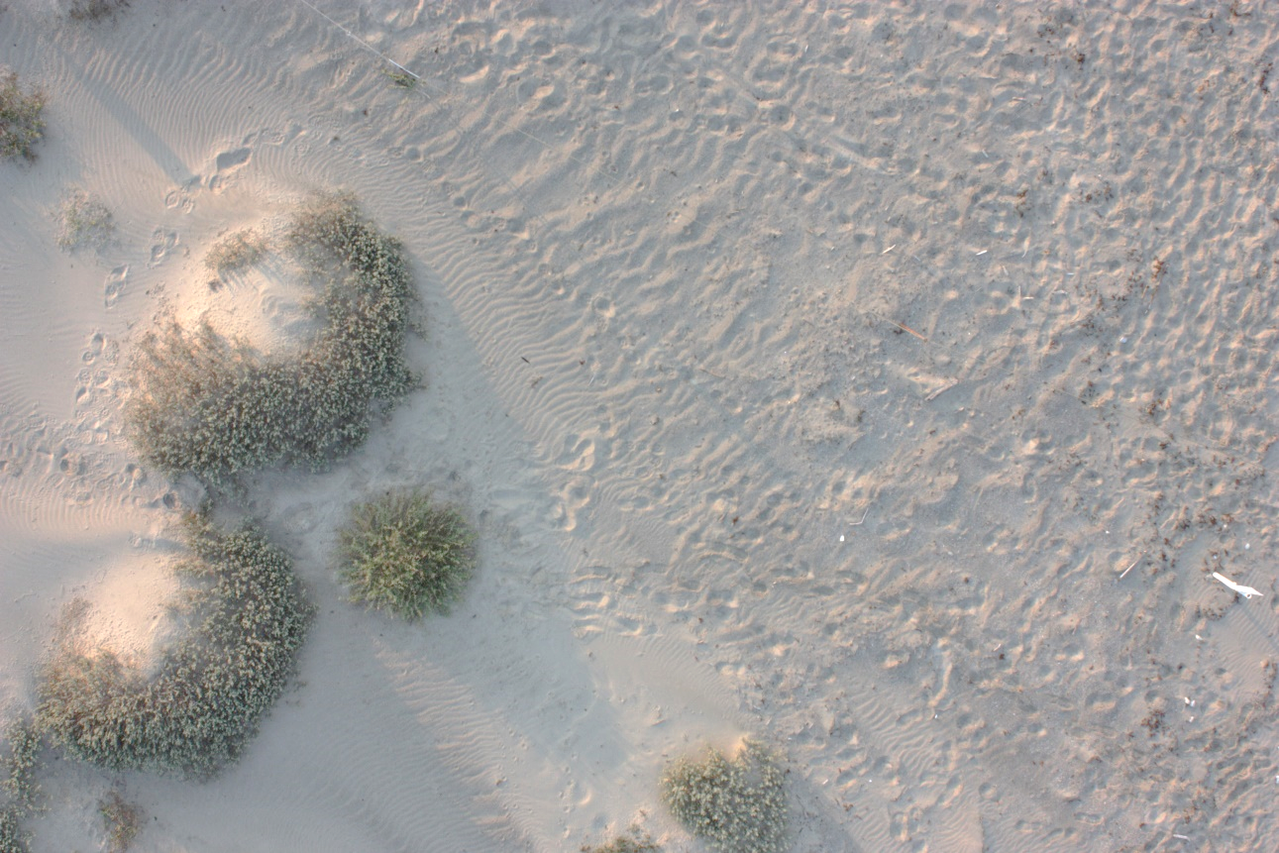
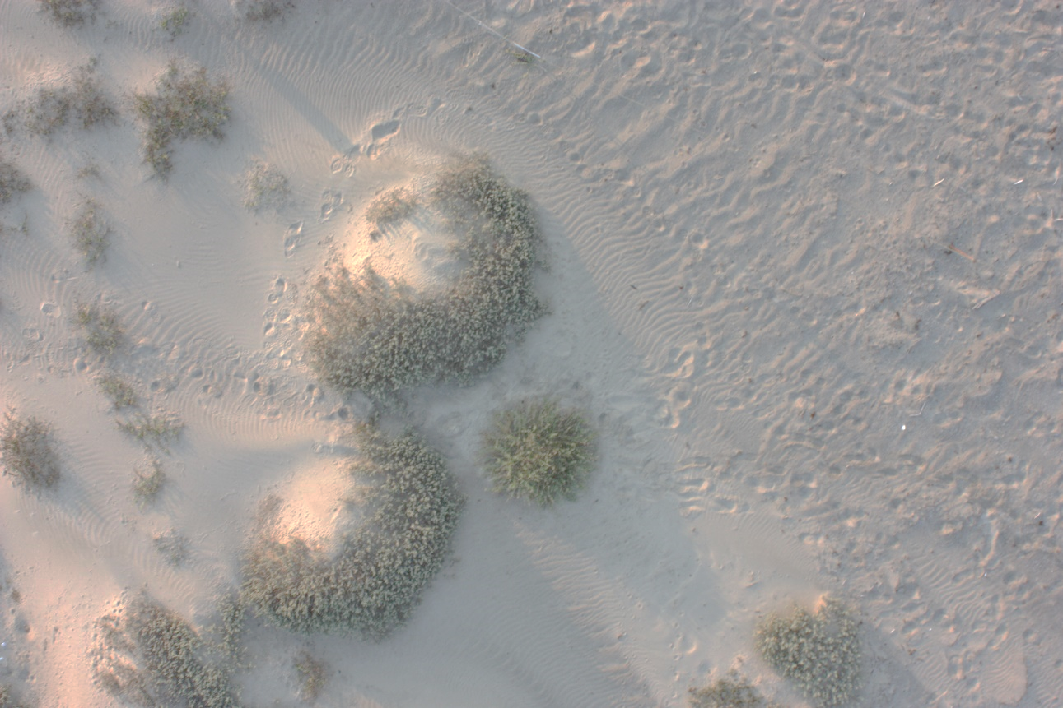
Structure from Motion
Matches features extracted from images with overlap
Image: Michelle Tobias

Slide 11
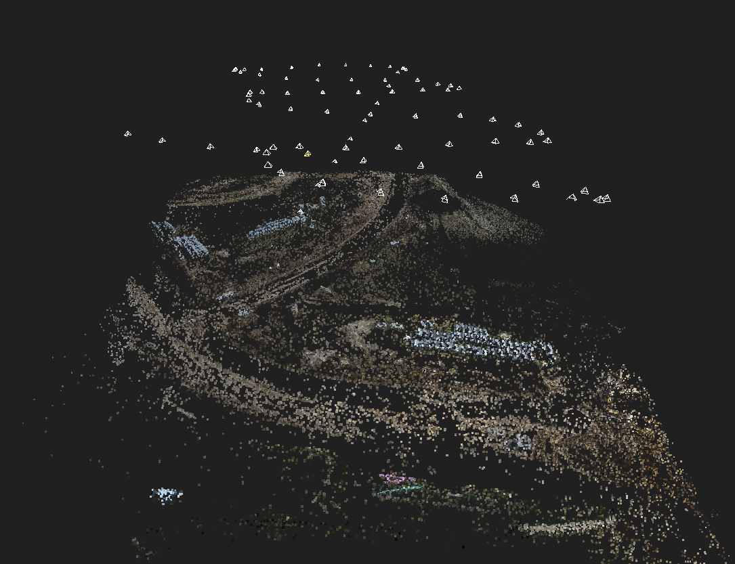
Image: https://geokota.wordpress.com/

Slide 12
ODM and the photogrammetric process
Structure from Motion
Point Cloud Densification
Poisson Surface Reconstruction
Multi-View Stereo Texturing
Orthophoto Generation

Slide 13
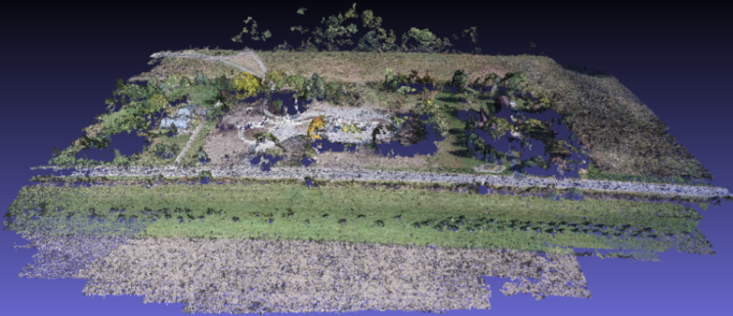
Sparse Point Cloud from Matching
Image: opendronemap.org
Notes:
(Photogrammetrically Derived Point Cloud)

Slide 14
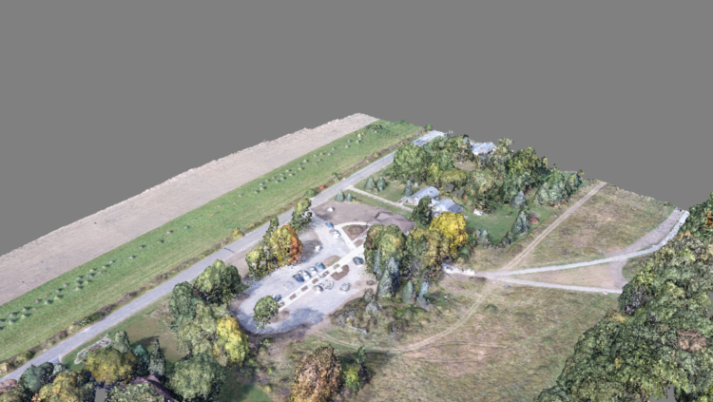
Dense Point Cloud
Image: opendronemap.org

Slide 15
ODM and the photogrammetric process
Structure from Motion
Point Cloud Densification
Surface Reconstruction
Multi-View Stereo Texturing
Orthophoto Generation

Slide 16
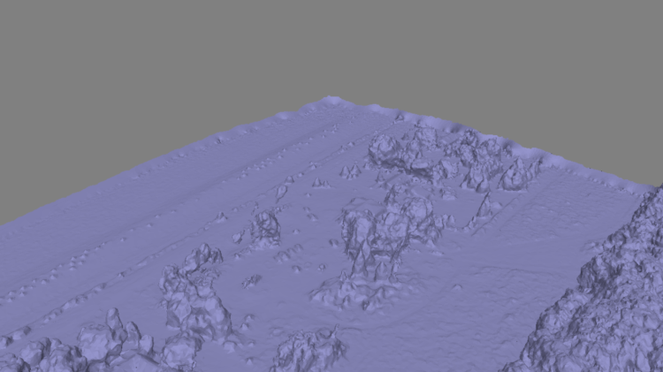
Mesh
Image: opendronemap.org
Notes:
Uses the Point Cloud Library (PCL), followed by mesh decimation

Slide 17
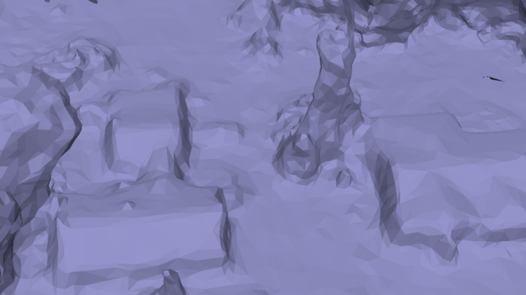
Mesh
Image: opendronemap.org
Notes:
Uses the Point Cloud Library (PCL), followed by mesh decimation

Slide 18
ODM and the photogrammetric process
Structure from Motion
Point Cloud Densification
Surface Reconstruction
Multi-View Stereo Texturing
Orthophoto Generation

Slide 19
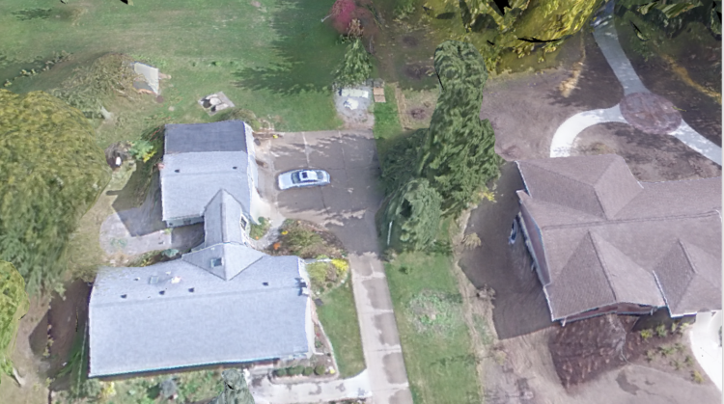
Texturing
Image: opendronemap.org

Slide 20
ODM and the photogrammetric process
Structure from Motion
Point Cloud Densification
Surface Reconstruction
Multi-View Stereo Texturing
Orthophoto Generation

Slide 21
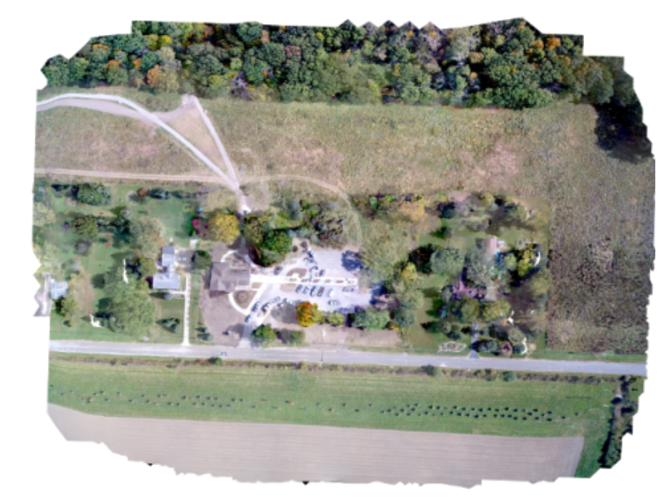
Orthophoto
Image: opendronemap.org

Slide 22
Use Cases

Slide 23
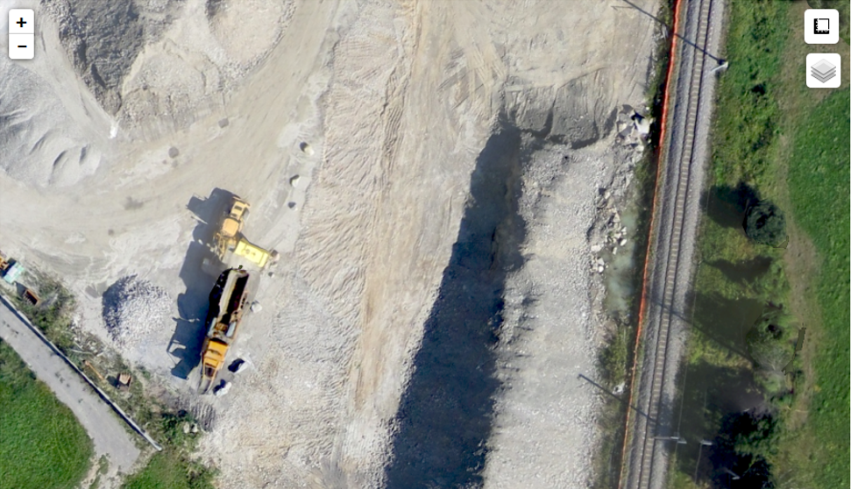
Construction
Drone with a standard (RGB) camera
Capture weekly images of construction site
Use ODM to generate orthophoto, 3D model
Use ODM linear, area, and volume measurements
Monitor as-built progress against plans
Updates to owners and other stakeholders
Image: Stephen Mather

Slide 24
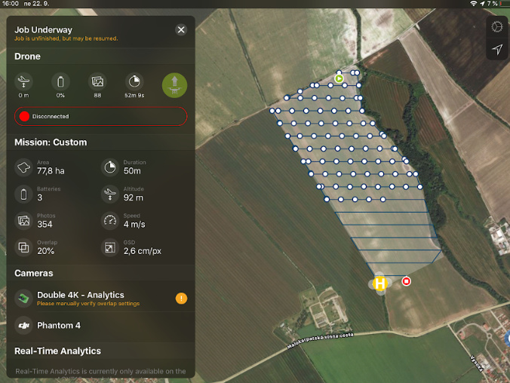
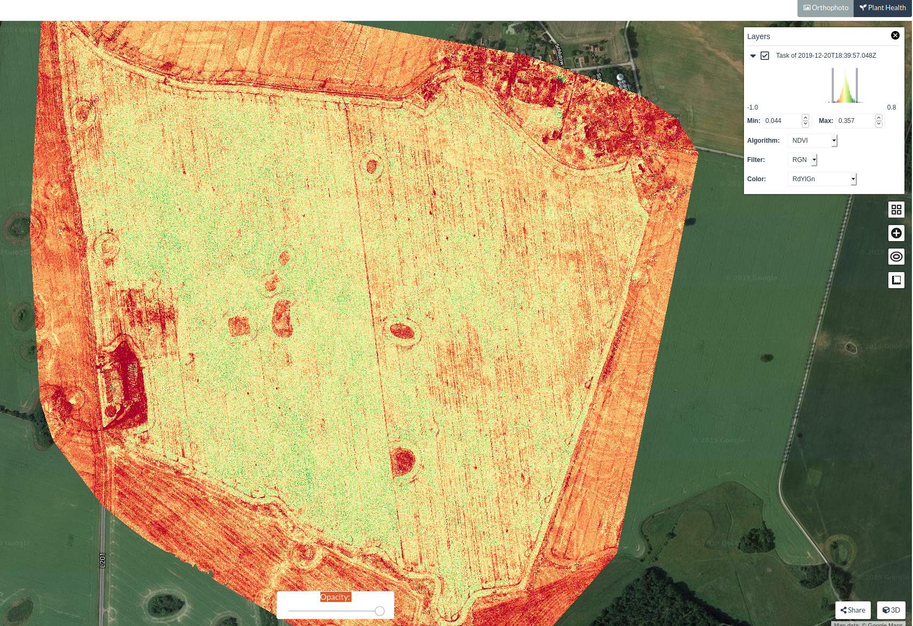
Agriculture
Drone with multispectral camera
Capture biweekly images of a large field
Use ODM plant health algorithms
Visually monitor crop health
Highlight areas of plant stress, for focused attention
Image: community.opendronemap.org

Slide 25
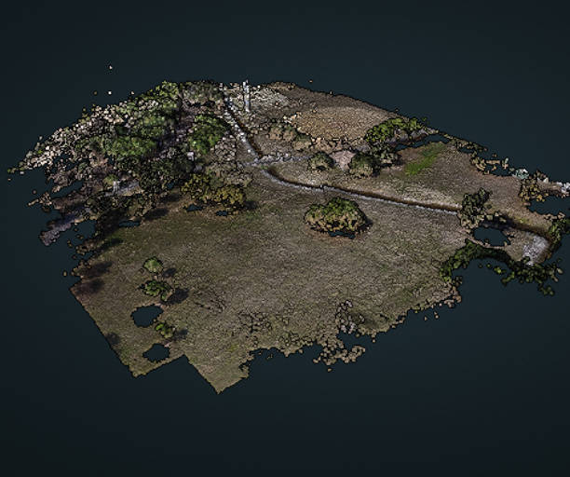
Emergency Management
Drone with standard camera
Quickly map a levee breach / flood area
Identify and quantify damage areas
Prioritize resources, work
Measure volume of fill material needed
Repeat flights to monitor progress
Image: opendronemap.org

Slide 26
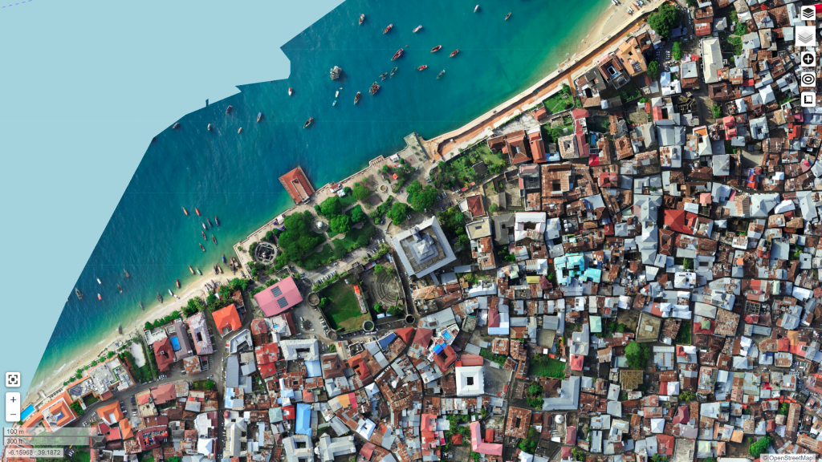
Coastal Monitoring
Drone with standard camera
Capture photos of a section of coastline
Use ODM to generate a 3D model
Repeat every 3 months
Export 3D models
Use another tool (e.g., CloudCompare) to assess change over time
Image: Stephen Mather

Slide 27
Using ODM

Slide 28
Supported Systems
Windows 10 (+ Docker)
Ubuntu Linux (native, or Docker)
MacOS

Slide 29
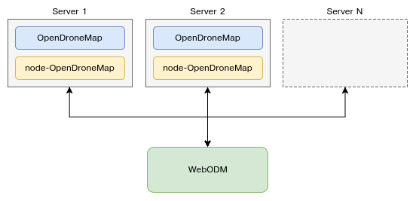
Ways to Use ODM
WebODM – most common
Manual (free)
Installer ($)
WebODM Lightning – easiest
Process on Lightning servers ($)
Command Line ODM
API (NodeODM)
LiveODM (USB or DVD) ($)
Portable OpenStreetMap (POSM)
Diagram: opendronemap.org

Slide 30
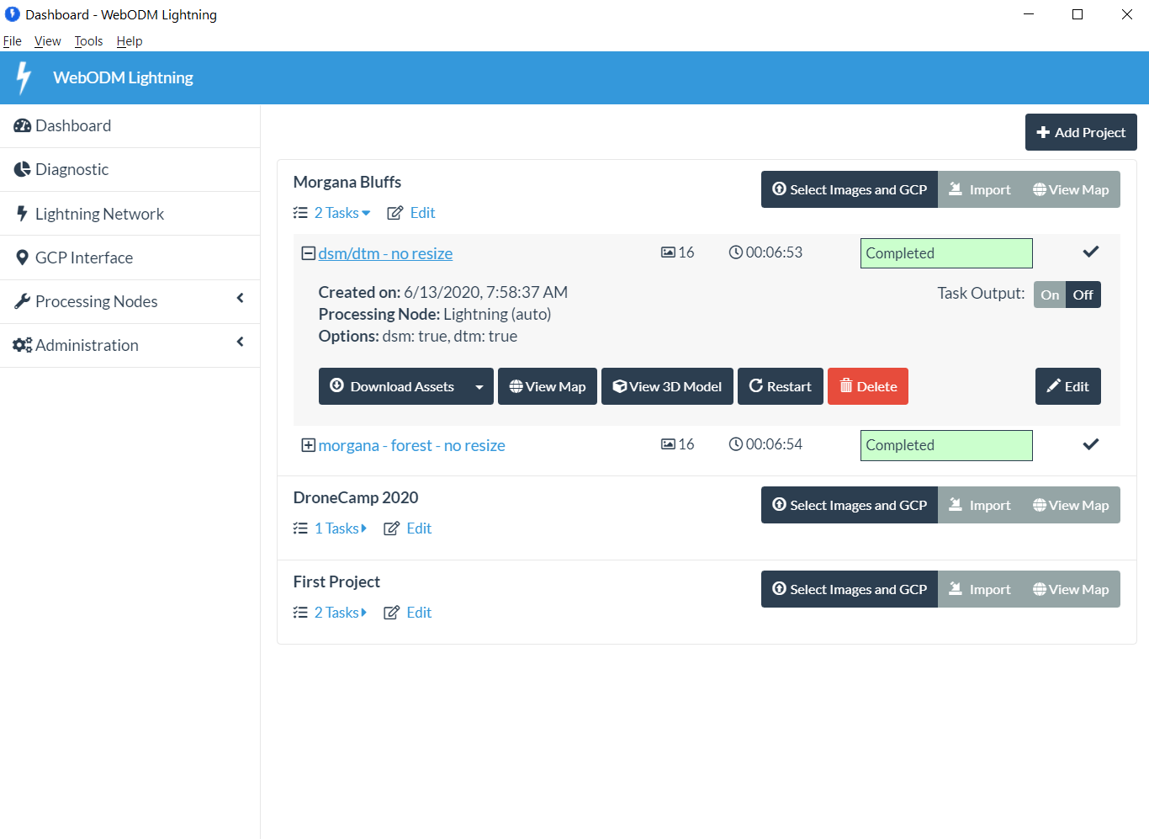
Dashboard

Slide 31
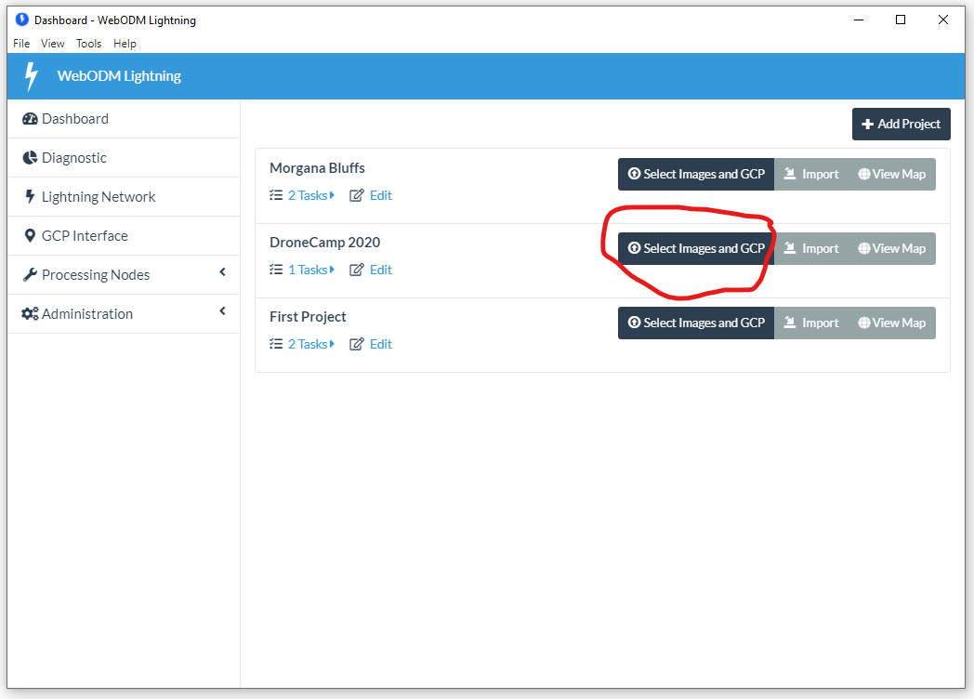
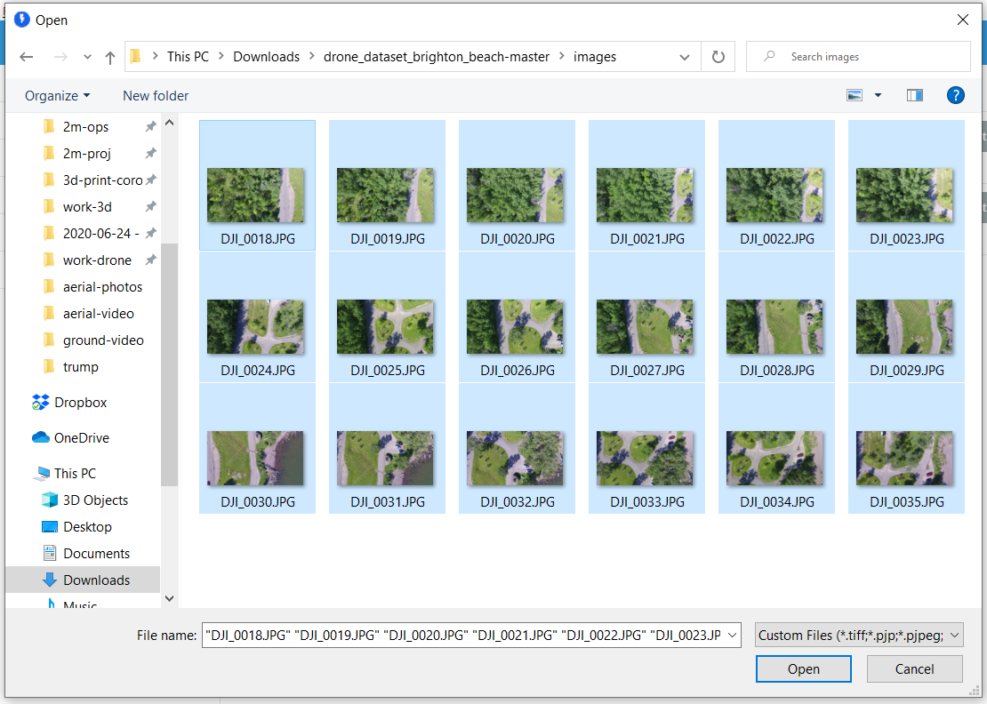
Add Images

Slide 32
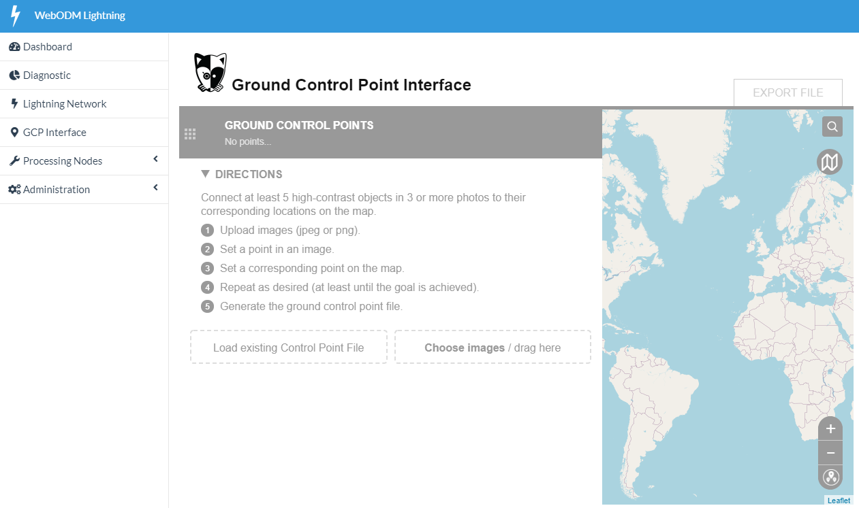
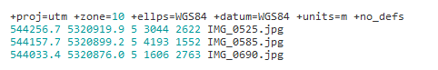
Add GCP (optional)
Built-in interface, or
GCP Editor Pro (external)
Include gcp_list.txt with images
See https://docs.opendronemap.org/gcp.html
gcp_list.txt

Slide 33
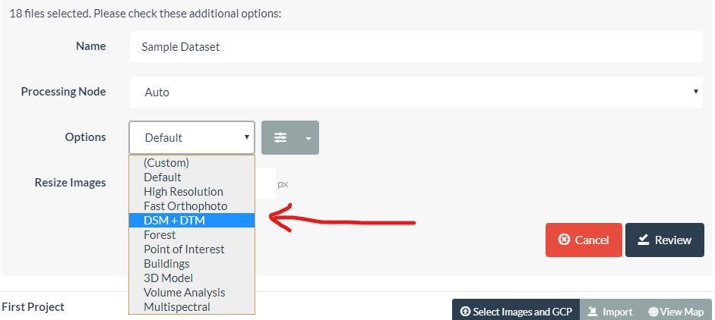
Set Configuration

Slide 34
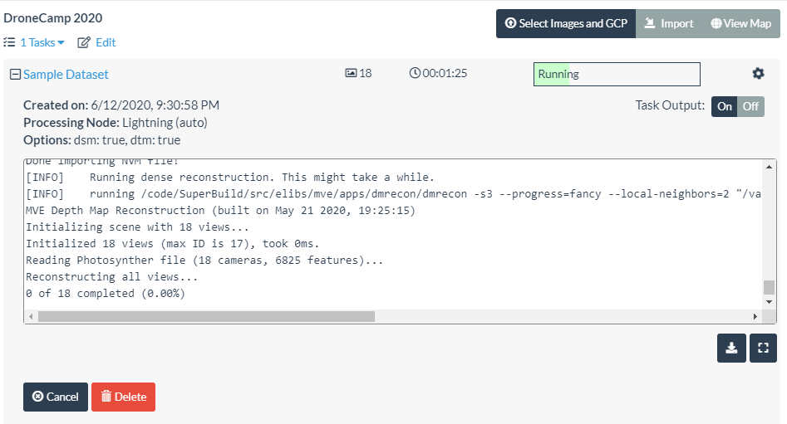
Processing

Slide 35
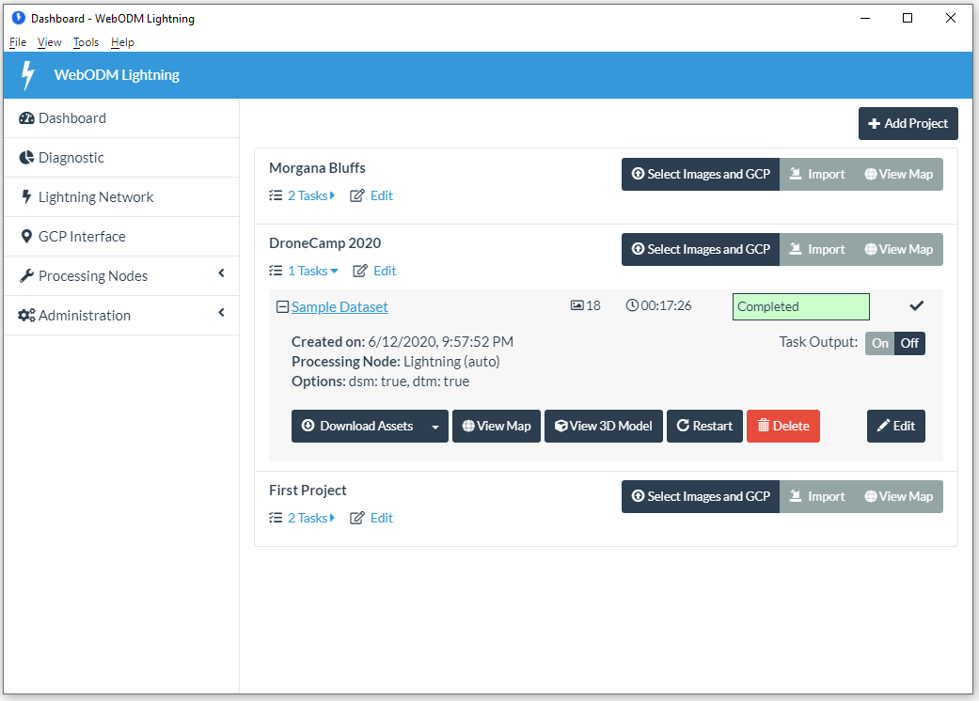
Finished

Slide 36
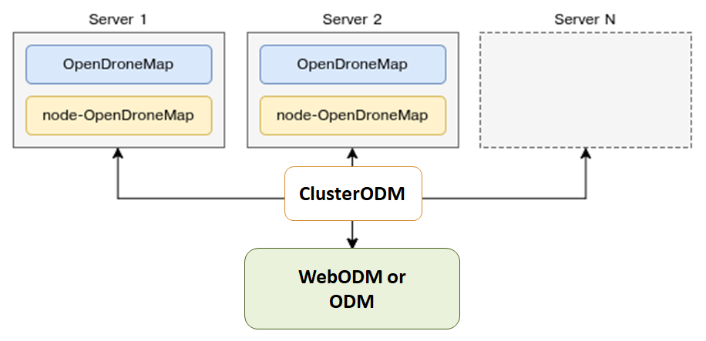
Split/Merge for Large Datasets
Diagram: opendronemap.org

Slide 37
Hands-On with ODM
(Part A - Start Processing)

Slide 38
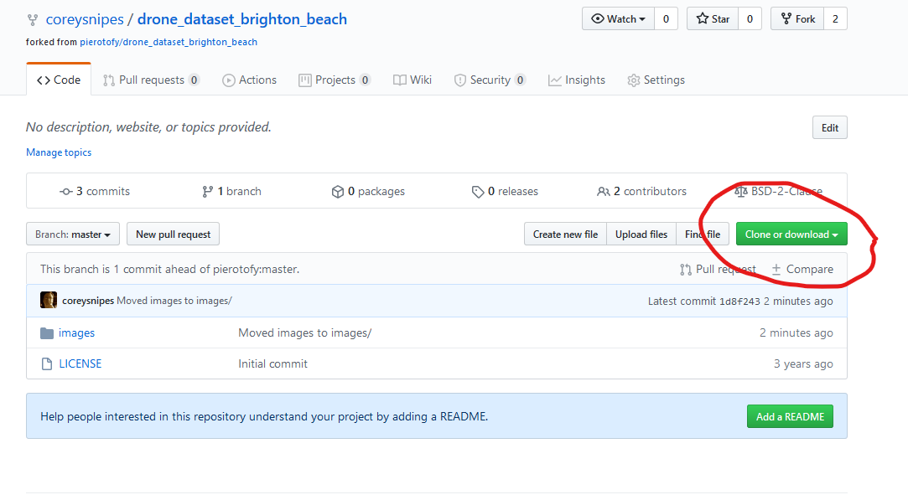
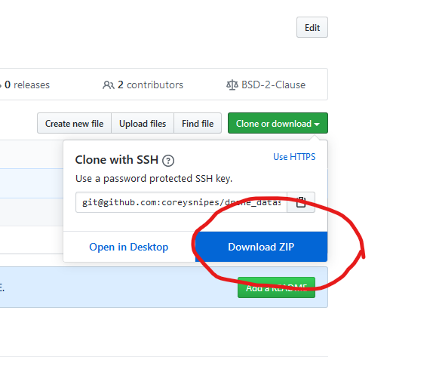
Download Sample Data
https://github.com/coreysnipes/drone_dataset_brighton_beach

Slide 39
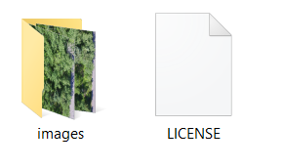
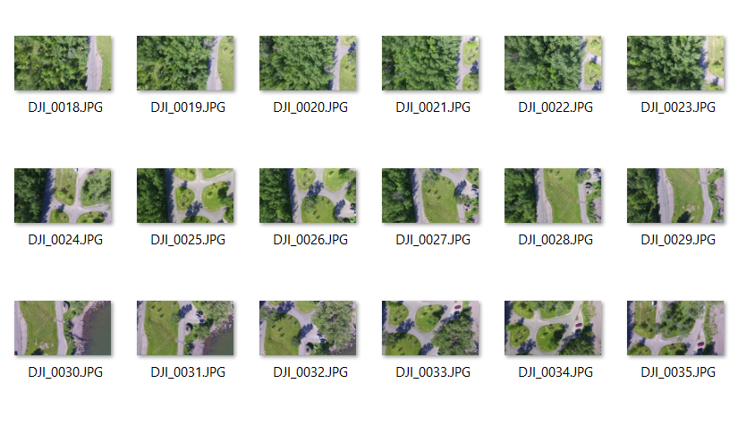
Unzip Files

Slide 40
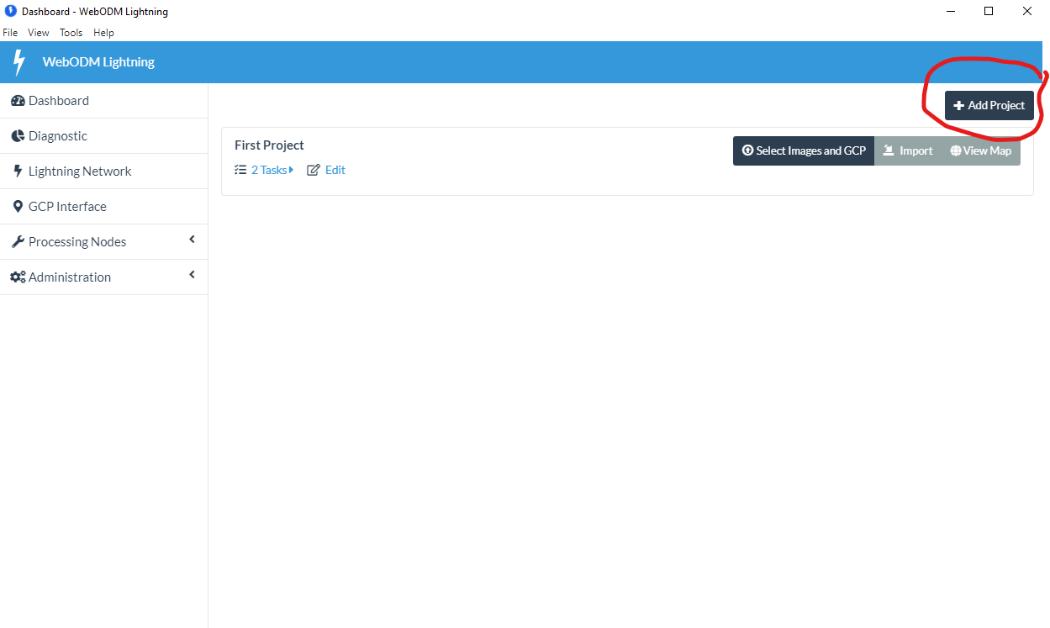
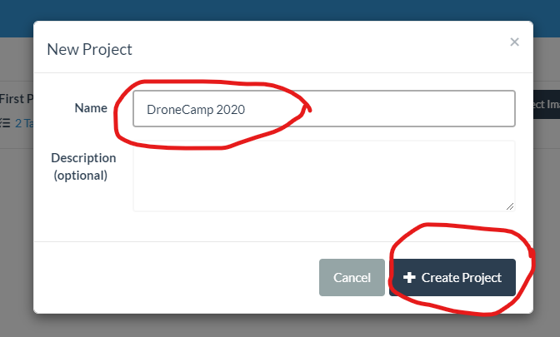
Open WebODM Lightning

Slide 41
Add Images

Slide 42
Add Images

Slide 43
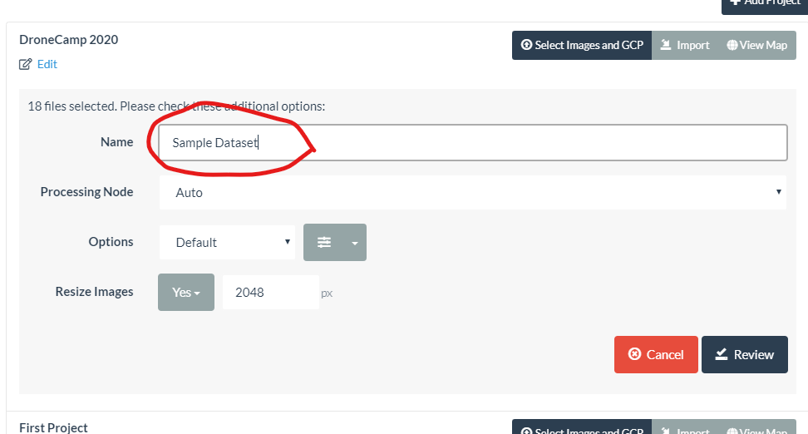
Set Configuration

Slide 44
Set Configuration

Slide 45
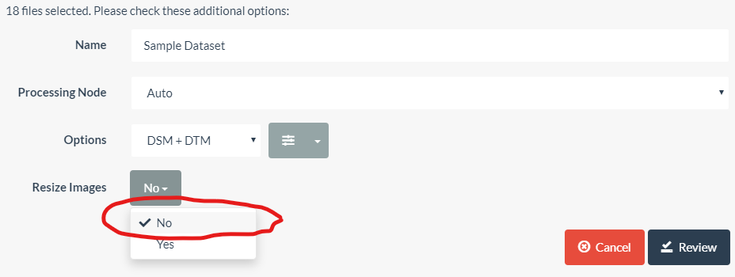
Set Configuration

Slide 46
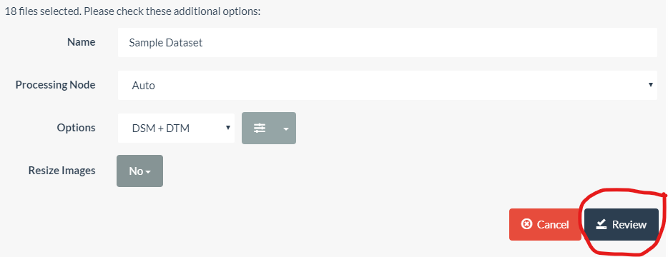
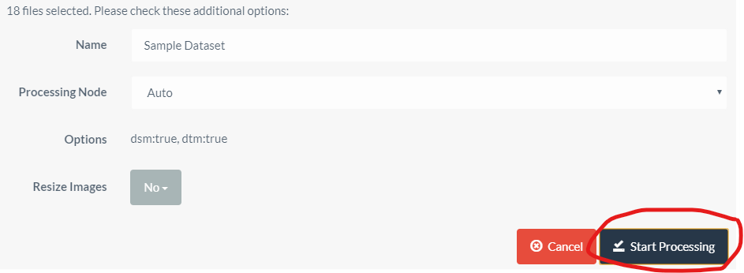
Start Processing

Slide 47
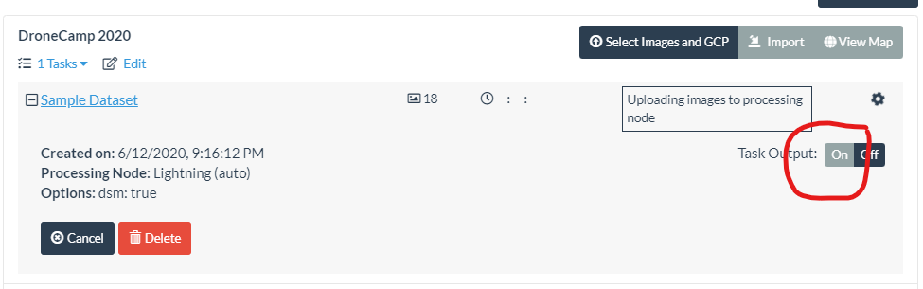
Processing Status

Slide 48
Running

Slide 49
Hands-On with ODM
(End of Part A)

Slide 50
Outputs

Slide 51
2D Ortho

Slide 52
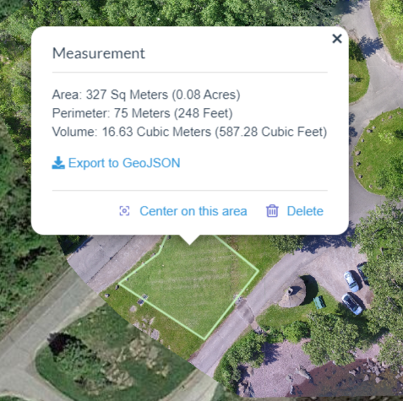
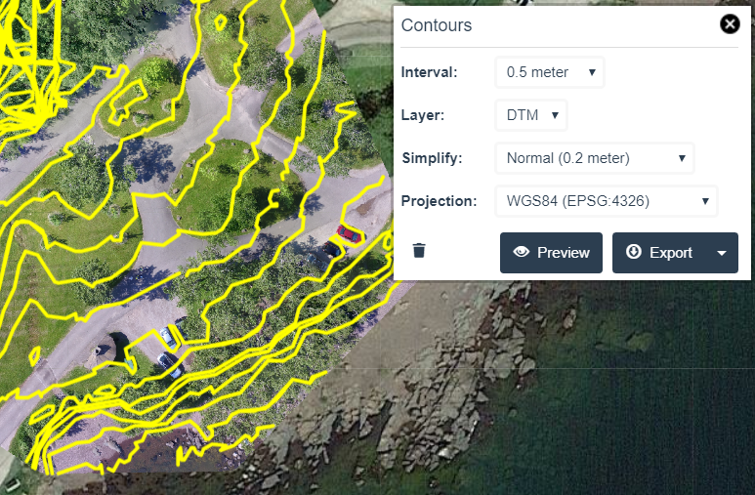
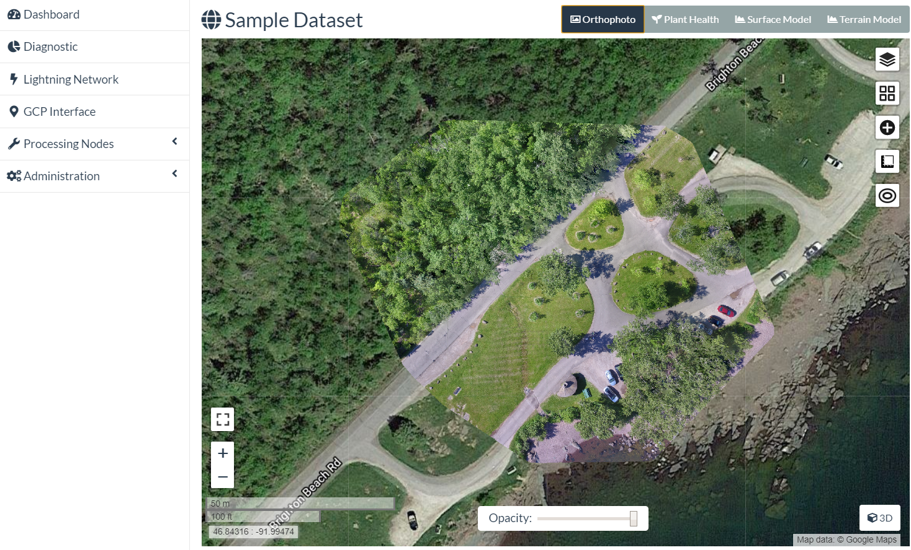
2D Orthophoto
Overlay on Google Map, OpenStreetMap, etc
Measurements (linear, area, volume)
Contour Lines

Slide 53
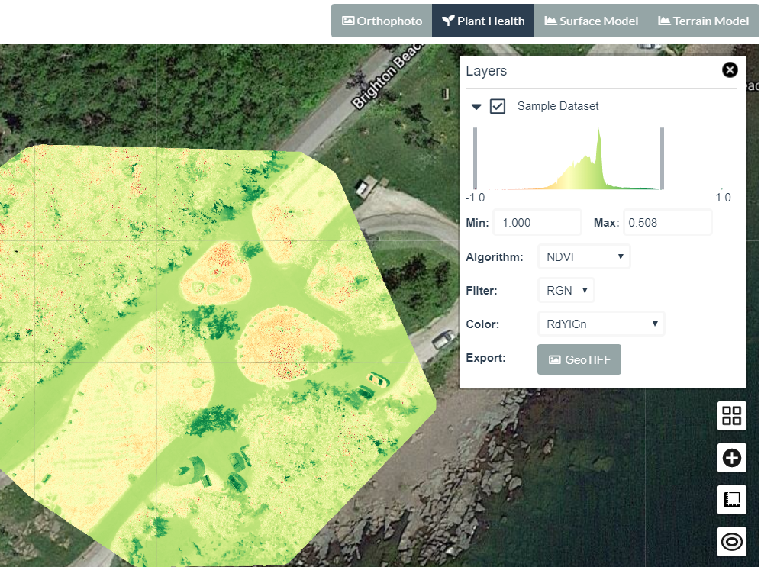
Plant Health Index
Images from multi-spectral cameras (Micasense, Sentera, etc)
Wavelengths beyond visible spectrum
Algorithms: NDVI, RDVI, GLI, SAVI, more

Slide 54
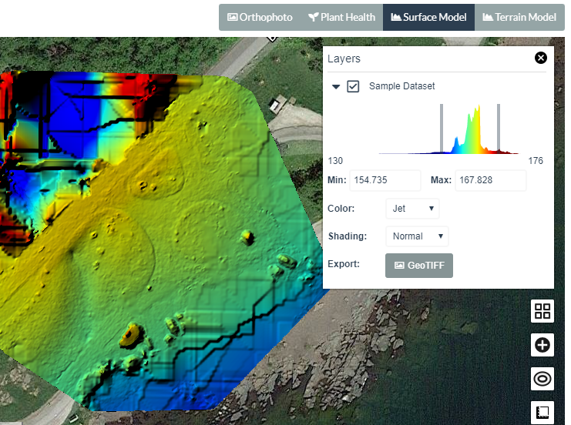
2D Surface Model (DSM)
Highlights surface altitude
Adjustable color ramps
Export GeoTIFF

Slide 55
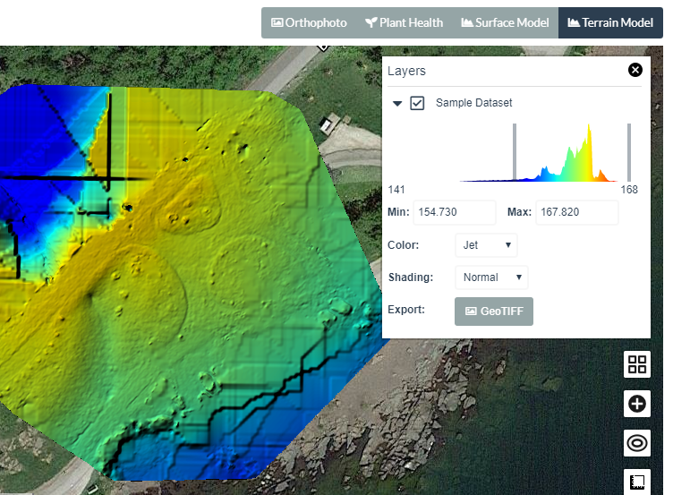
2D Terrain Model (DTM)
“The DSM without the trees”
Uses point classification to remove objects from the surface model
Ground (terrain) profile
Contour lines

Slide 56
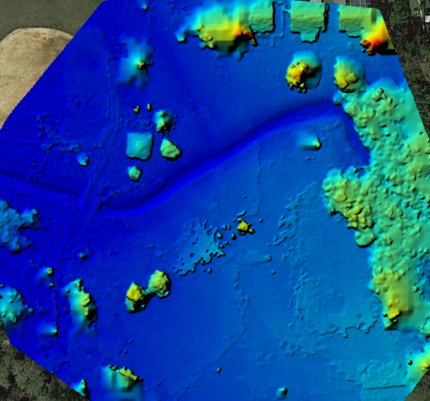
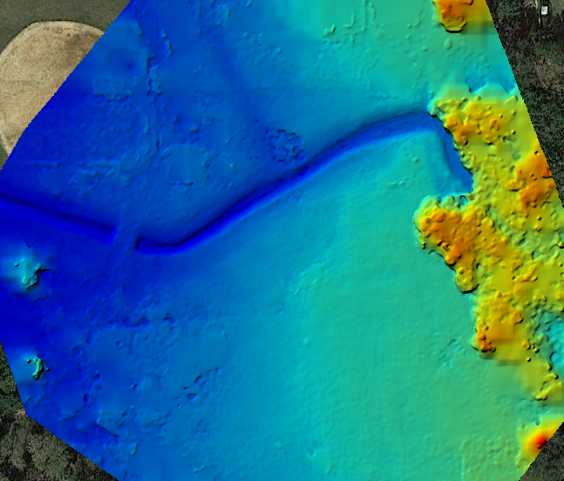
2D Terrain Model (DTM)
DSM
DTM
Images: opendronemap.org

Slide 57
3D Model

Slide 58
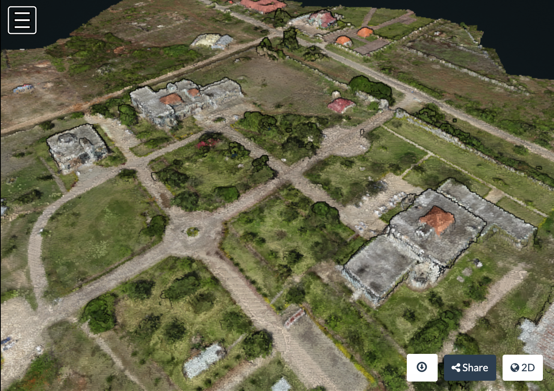
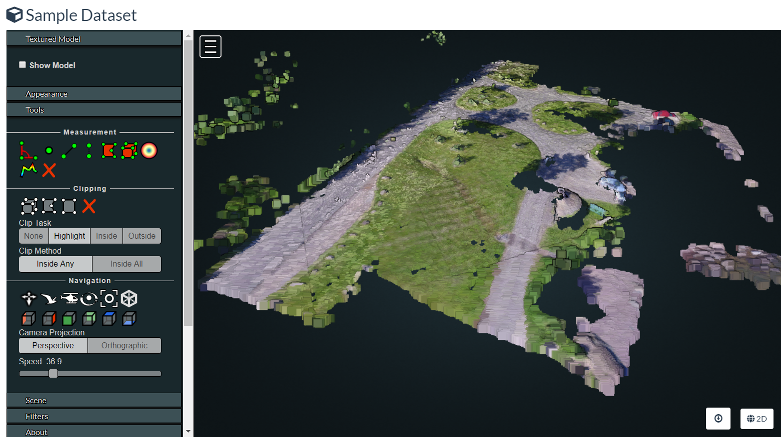
Point Cloud
Individual points
X, Y, Z
Image: opendronemap.org

Slide 59
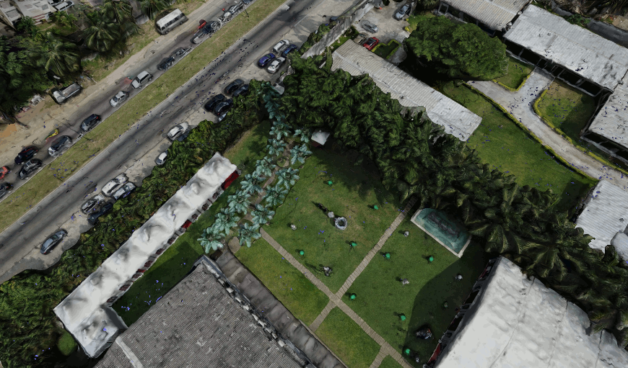
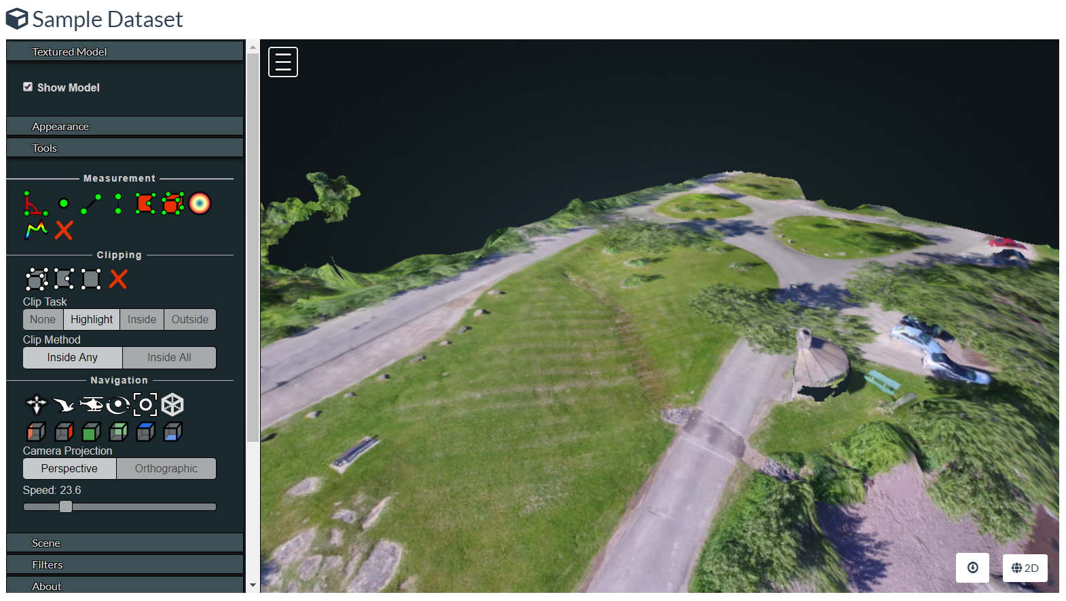
Textured Model
Identify surface triangles
Point Cloud -> Surface Mesh
Image: opendronemap.org

Slide 60
3D Measurements
Linear
Area
Angle
Height
Height Profile
Volume

Slide 61
Download
Orthophoto (GeoTIFF or Tiles)
Terrain Model / DTM (GeoTIFF or Tiles)
Surface Model / DSM (GeoTIFF or Tiles)
3D Point Cloud (.laz)
3D Textured Model (.obj)
Camera Parameters

Slide 62
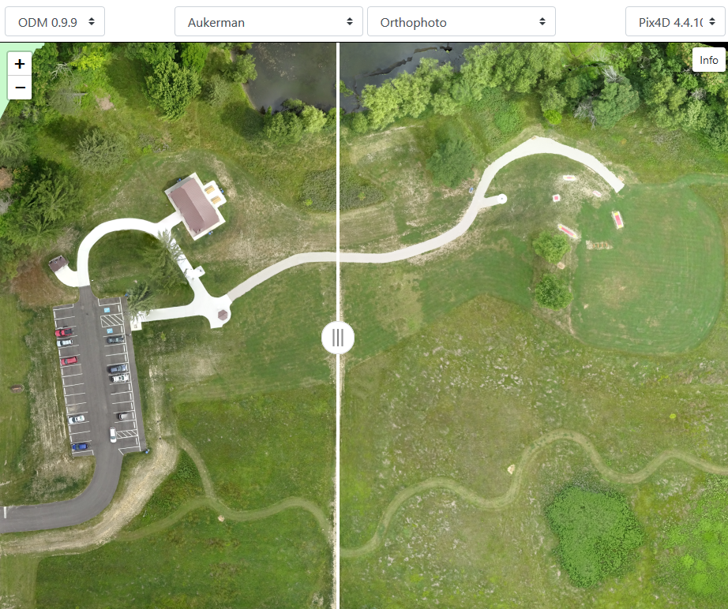
Output Quality
Comparable to commercial products
Commercial output quality can be better with:
Default settings
Poor flight coverage
ODM produces comparable quality with:
Sometimes with default settings
Often with tuned settings
Good flight coverage (overlap, multiple POV)
https://opendronemap.github.io/UAVArena/

Slide 63
Pitfalls

Slide 64
Common Problems
Many paths to get started with ODM.
Where to start?
All require some work
Starting with a large dataset
System resources
Machine spec
Docker allocations
Processing is hung (or is it?)
Processing failed, but not sure why
Output quality vs. expectation

Slide 65
Future Direction

Slide 66
Upcoming Features
Reporting statistics
GPU support
Processing speed improvements
Thermal images support
Supplemental images from ground- and 360-cameras

Slide 67
Summary

Slide 68
Summary
ODM is a set of tools for 2D mapping and 3D modeling
ODM is Open Source, with benefits in
Cost
Control
Uses
Site assessment
Site monitoring
Disaster response
Construction, agriculture, mapping

Slide 69
Summary, Continued
2D outputs
Orthophoto
Terrain/Surface Models
Plant Health
3D outputs
Point cloud
Textured mesh
Complex to start, can be fiddly to use
Output quality is comparable to commercial software
Community has momentum

Slide 70
Learning More

Slide 71
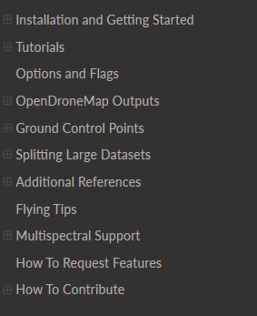
ODM Docs
https://docs.opendronemap.org

Slide 72
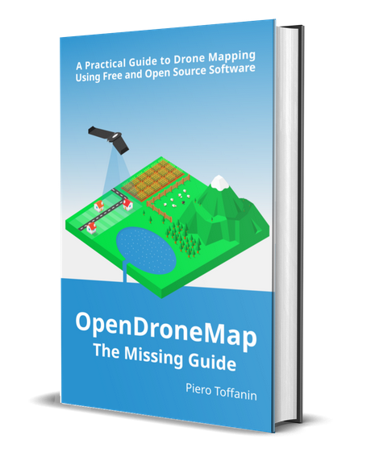
ODM Book
https://odmbook.com
$30
Image: odmbook.com

Slide 73
UAV Arena
Compare Outputs
ODM
Pix4D
DroneDeploy
Agisoft Metashape
DroneMapper
https://opendronemap.github.io/UAVArena/

Slide 74


Community Forum
https://community.opendronemap.org

Slide 75
Questions?
https://opendronemap.org
Corey’s Contact Info
Presentation Credits
@coreysnipes
corey@twomile.com
https://www.linkedin.com/in/coreysnipes/
Stephen Mather ODM, Cleveland Metroparks
Piero Toffanin ODM, UAV4GEO
Screenshots and interface images by
Corey Snipes, unless otherwise noted.

Slide 76
Q&A / Break
(~15 minutes)

Slide 77
Hands-On with ODM
Part B – Working with ODM Outputs

Slide 78
WebODM vs. WebODM Lightning
WebODM
Install for free
Process locally for free
WebODM Lightning
Commercial service
Install for free
Process in the cloud ($)

Slide 79
Still Running?

Slide 80
Finished
Today, Speed > Quality

Slide 81
Exercises – 2D Orthophoto

Slide 82
#1 – Orthophoto - Navigate
Click+hold = move map
Scroll wheel = zoom in/out
Map controls +/- = zoom
Map control square = full screen
Top buttons:
Ortho
Plant Health
Surface Model
Terrain Model

Slide 83

#2 – Orthophoto - Measure
Click ruler (4th on right)
Create new measurement
Click 2 points on map
Click “Finish measurement”
View calculations in white balloon
Close balloon with “x”
Click ruler again, new measurement
Click 4 points on map to make a box, click “Finish”
View calculations
Click “Delete” to remove it

Slide 84

#3 – Plant Health
2nd Top Button: Plant Health
Note color differences in different grassy areas
Click top right “layers” icon
View “Algorithm” options
View “Color” options
Drag min/max bars
Export GeoTIFF

Slide 85

#4 – Surface Model (DSM)
3rd Top Button: Surface Model
Wait for calc/load
Note color varies by altitude
Click top right “layers” icon
View “Color” options
Drag min/max bars
Wait for refresh
Export GeoTIFF

Slide 86

#5 – Terrain Model (DTM)
4th Top Button: Terrain Model
Wait for calc/load
Note color varies by altitude
Click top right “layers” icon
View “Color” options
Drag min/max bars
Wait for refresh
Export GeoTIFF

Slide 87
Exercises – 3D Model

Slide 88

#6 – 3D Model - Navigate
Left click+drag = rotate model
Right click+drag = move model
Scroll wheel = zoom in/out
Top left (3 bars) button = collapse tools
Top left (map) button = show model location
Tools
Measure
Navigation
Appearance
Scene

Slide 89

#7 – 3D Model – Measure (Linear)
Adjust the model so you can see
Click 3rd Measurement tool (angled line)
LEFT click 2 points in a grassy area on the map
Now RIGHT click the last point to finish
View measured distance (m)
Click red “X” in measurement tools, to delete

Slide 90

#8 – 3D Model – Measure (Area)
Adjust the model so you can see
Click top right Measurement tool (red box)
LEFT click 4 points in a grassy area on the map
Now RIGHT click the last point to finish
View measured distances (white)
View measured area (green)

Slide 91

#9 – View Textured Model
Find “Textured Model” near the top of the tool menu
Click to expand, then click “Show Model”
Wait a few seconds
View how the scene becomes more detailed, holes are filled
Uncheck and check the box to turn off, and on
Move the model around to view other parts
Edges of model = lots of error Interior of model = better precision

Slide 92

#10 – View Cameras
Find “Cameras” near the top of the tool menu
Click to expand, then click “Show Cameras”
Zoom out (scroll) until you see the blue squares floating above the scene
Note positions, angles of cameras
Click one camera to see the photo from that position

Slide 93
Exercises – Download

Slide 94


#11 – Download Orthophoto

Slide 95




#12 – Download All

Slide 96
Hands-On with ODM
(End of Part B)

Slide 97
Questions?
https://opendronemap.org
Corey’s Contact Info
Presentation Credits
@coreysnipes
corey@twomile.com
https://www.linkedin.com/in/coreysnipes/
Stephen Mather ODM, Cleveland Metroparks
Piero Toffanin ODM, UAV4GEO
Screenshots and interface images by
Corey Snipes, unless otherwise noted.

Slide 98
Backup

